Slide 1
Prediction of fare of Airline tickets
Team Name: Probability Knights
Members:
Prateek Gupta E22CSEU0128
Yashvi E22CSEU1787

Slide 2
Abstract
In recent times, the aviation industry has witnessed a substantial surge in airline ticket prices, driven by a multitude of influential factors. This project is dedicated to the development of a predictive model for airline fares, using a diverse set of features such as the number of stops between the source and destination, airline carrier, departure and arrival times, among others. Our research encompasses comprehensive data visualization and analysis, providing us with valuable insights that are presented within this project. Employing a range of machine learning models, we have rigorously assessed their performance to identify the most suitable model for our predictive task.

Slide 3
Introduction
The aviation industry, like many others, experienced a profound impact due to the onset of the Covid-19 pandemic. Despite managing to make a gradual recovery after the initial restrictions were lifted, the industry is still dealing with numerous challenges.
Chief among these challenges is the sharp increase in airline ticket prices, with jet fuel costs surging by nearly 150%. This increase has had a cascading effect on travelers' expenses, making informed ticket booking an imperative need.
With billions of individuals traveling by air annually, this project aspires to provide a valuable solution by creating a predictive model for airline fares.
The primary goal is to empower travelers with the ability to anticipate ticket prices accurately, enabling them to make well-informed booking decisions and avoid unnecessary expenses.

Slide 4
Method
For this project we have used the dataset “Flight_data.csv” which contains 11 different features.
We have performed univariate and bivariate analysis on different features and the dataset to understand its properties.
We have performed label encoding and one hot encoding on the features of the data set so that they can be used for our different predictive models
In the project we have employed three different ML models viz:
Linear regression model
Decision Tree model
Random Forest Model

Slide 5
After encoding the data, we have also performed outlier detection on the data to make our models more robust.
For dealing with outliers, we have employees the Inter Quartile range Method
We have replaced all the outliers values in the Price feature with its median as it is the most unaffected quantity due to outliers.

Slide 6
Linear Regression
Linear regression is type of statistical analysis use to predict relationship between many independent variables and one dependent variable.
It assumes a linear relationship between the independent and dependent variables and aims to find the best fit hyperplane between the independent and dependent variables
It requires data to be on the same scale for more precise predictions. In this project we have scaled down our data using min-max scaling method.
We then pass this data to the model and train it.
We evaluate the model’s performance with the help of metrics like Mean Squared Error, Mean Absolute Error and R2 score.

Slide 7
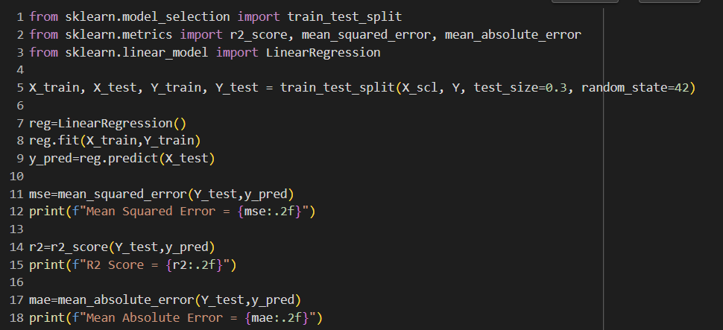
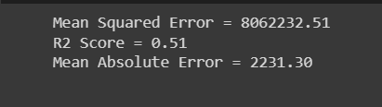
Linear Regression Code Snippet

Slide 8
Decision Tree
A decision tree builds a flow chart like data structure where each node denotes a test on an attribute, each branch represents the outcome of the test and each leaf node holds a class value.
One of its best advantages is that it does not require data to be scaled and can use raw data
In this project we have employed “GridSearchCv” function available in the Sklearn library to find the best parameters for our decision tree.

Slide 9
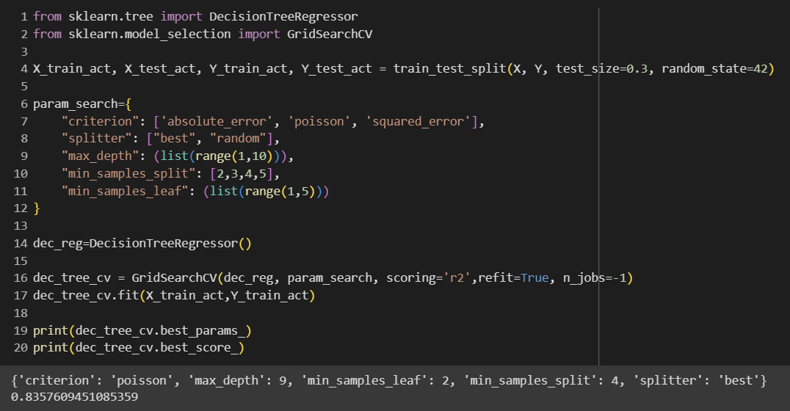
Finding best parameters for decision tree

Slide 10
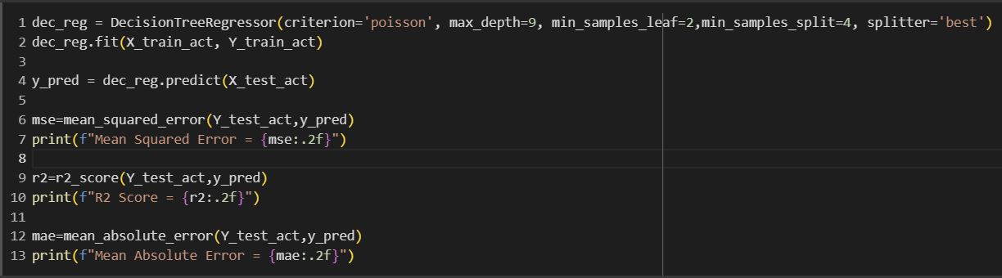

Decision Tree code snippet

Slide 11
Random Forest
A random forest algorithm employs the use of multiple decision trees to give a final outcome
It is an extension of the bagging(Bootstrap aggregation) method.
This algorithm is quite useful one the dataset contains a lot of features and its size is also large
In the project we have performed hyper tuning of random forest using “RandomSearchCV” method from sklearn to find the best parameters for our random forest

Slide 12
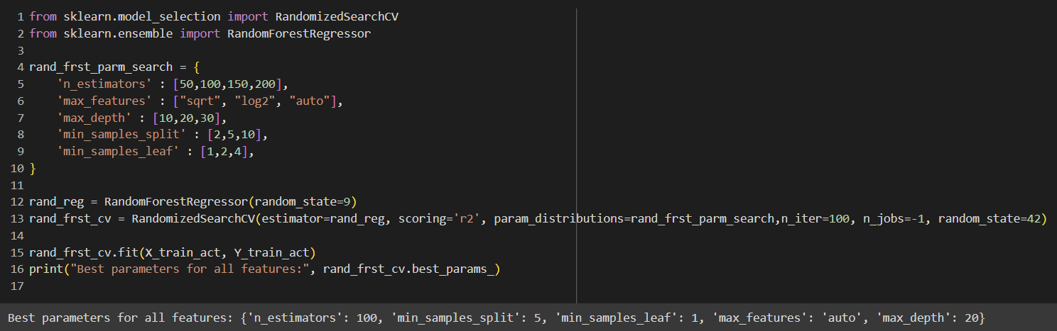
Finding best parameters for Random Forest

Slide 13
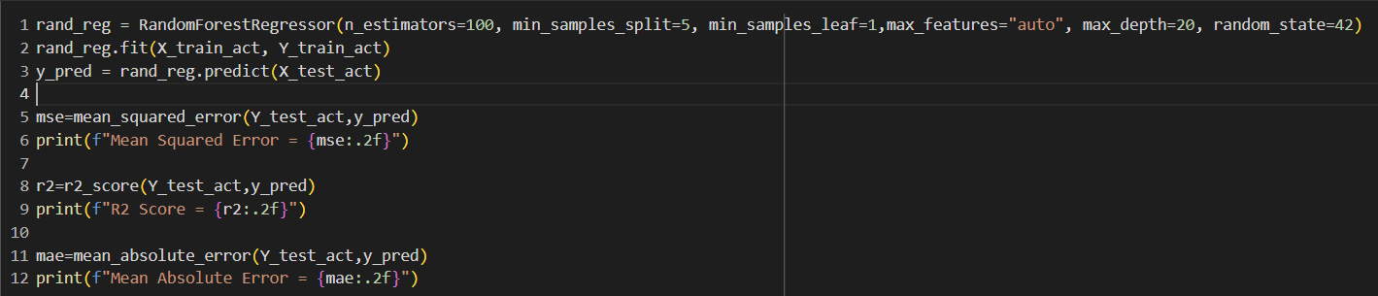
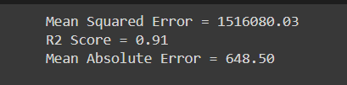
Random Forest code snippet

Slide 14
Results
The result of the various models used have been compiled below:
Model | MSE | MAE | R2 score
Linear Regression | 8062232.51 | 2231.3 | 0.51
Decision Tree | 2526664.18 | 973.18 | 0.85
Random Forest | 1516080.03 | 648.5 | 0.91

Slide 15
Conclusion
As can be inferred from the table, the best model to use for predicting the fares of different airlines is the Random Forest model.
It gives an R2 score of 0.91 and a Mean absolute error of 648.5 .
We can use tis model to make an application for all travellers in which they can provide details of their journey and get the estimated airline fares based on the same.
This will enable them to make well informed decisions regarding their trip and avoid unnecessary expenses.

Slide 16
Thank You

